Slide 1
Reversible ligand binding
Andrea Bellelli
Dipartimento di Scienze Biochimiche “A. Rossi Fanelli”
Sapienza Università di Roma

Slide 2
The reversible combination of a protein with a low molecular weight ligand is extremely common and important in biology:
oxygen transport; transport of poorly soluble substances
combination of hormones and receptors or neuromediators and receptors
combination of enzymes with their substrates
antigen-antibody reactions
chemotaxis; recognition of smell and flavor
…

Slide 3
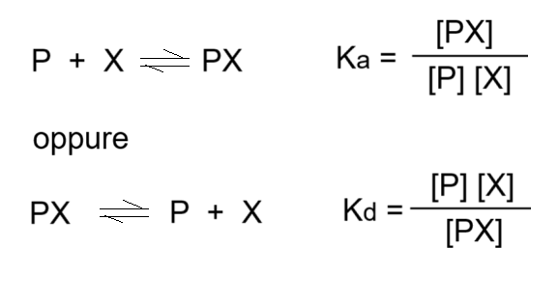
The reversible binding between a protein and a ligand obeys the mass action law:
Often the dissociation constant is preferred because it has as dimension a molarity and hence it can be directly compared with the ligand concentration.

Slide 4
The fraction of iganded protein: [PX] / [P]tot
A biologically relevant parameter is the fraction of liganded protein; for example a cell might respond to a hormone when at least, say, 20% or 30% of its receptors are liganded. We define:
[P]tot = [P] + [PX]
Kd = ([P]tot - [PX]) [X] / [PX]
[PX] (Kd + [X]) = [P]tot [X]
[PX] / [P]tot = [X] / (Kd + [X])

Slide 5
The concept of [X]50
From the equation: [PX] / [P]tot = [X] / (Kd + [X]) we can derive the ligand concentration required to obtain any degree (fraction) of ligation. Typically the relevant or required parameter is the ligand concentration required to achieve the semisaturation of the ligand binding sites ([X]50):
[PX] / [P]tot = 0,5 = [X]50 / (Kd + [X]50)
2 [X]50 = Kd + [X]50
[X]50 = Kd
The ligand concentration required for saturating half the binding sites equals the Kd.

Slide 6
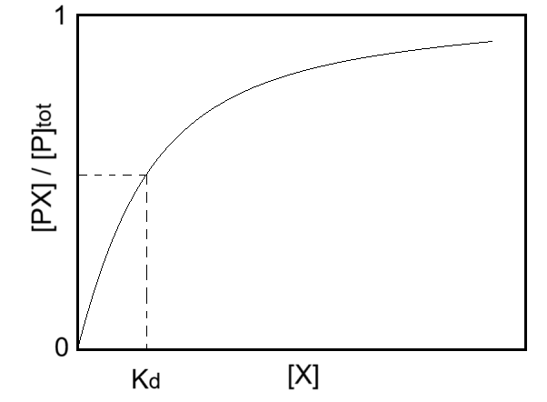
The [PX]/[P]tot versus [X] graph is a hyperbola

Slide 7
How to design the experiment
The measurement of Kd and/or the binding stoichiometry demands one or more experiments. The most common type of experiment relies on the preparation of a protein solution at known concentration to which aliquots of ligand are progressively added.
An instrument capable of detecting a signal proportional to the fraction of liganded protein is required.
Thus we need:
to decide the concentrations of protein and ligand
to select the signal we want to detect and the appropriate instrument

Slide 8
Deciding the protein concentration
Usually (but not always) the protein is the species that produces the signal; thus the protein concentration is usually determined by the sensitivity of the instrument we use.
For example, if the signal is an absorbance change, and the instrument selected is a spectrophotometer, the optimal concentration should yield a difference in absorbance between 0,2 and 0,8 absorbance units. This, if we use an optical path of 1 cm, is consistent with protein concentrations in the order of 0.1 mM, given the typical molar extinction coefficients of proteins and their cofactors.

Slide 9
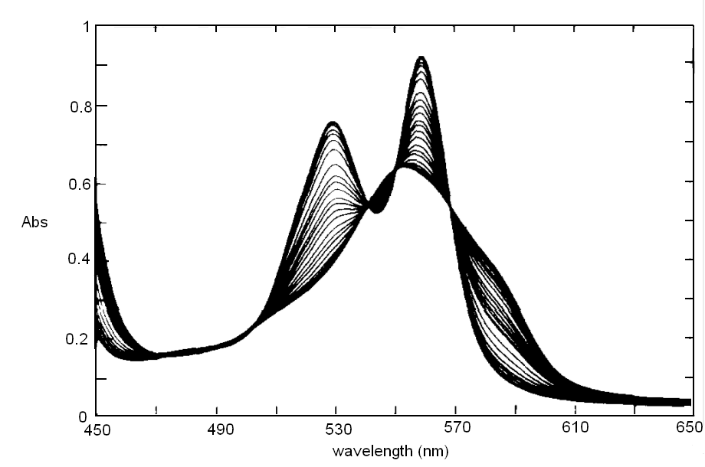
Reversible binding of n-propyl isocyanide to human hemoglobin, monitored by absorbance spectroscopy (modified after Reisberg and Olson, J. Biol. Chem. 1980, 255, 4144-4150)

Slide 10
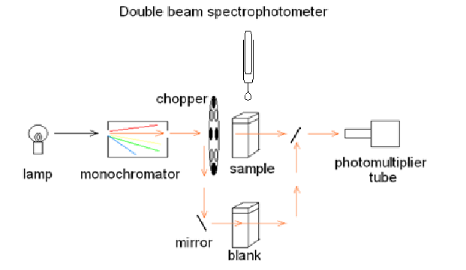
Scheme of a spectrophotometer

Slide 11
Explore a large interval of protein concentration
Because of reasons we are going to discuss later, and given that the ligand concentrations to explore are fixed by its Kd:
a low protein concentration is required if we want to measure Kd;
a high protein concentration is required if we want to determine the reaction stoichiometry;
using several methods to detect the binding of the ligand allows us to extend the accessible range of protein concentration; for example our reaction could yield an absorbance signal and a fluorescence signal, and if we use both we take advantage of the fact that fluorescence requires a two order of magnitude lower protein concentration than absorbance.

Slide 12
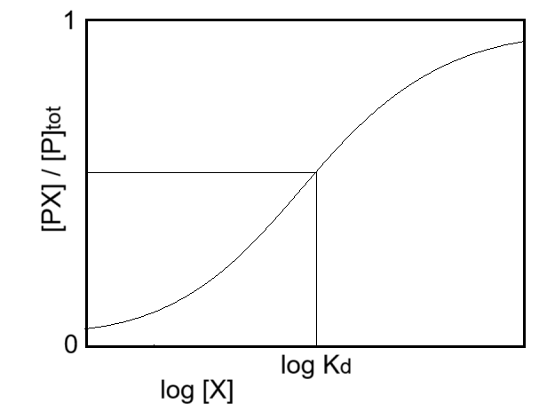
Deciding the ligand concentration
The ligand concentration to be explored depends on Kd. If we plot [PX] / [P]tot versus log [X] we obtain a symmetric sigmoid curve centred on the point with coordinates:
log [X]50 = log Kd
[PX] / [P]tot = 0.5

Slide 13
The ligand concentration to explore is between 1/20 of Kd (which yields [PX]/[P]tot = 0,05) and 20 times the Kd (which yields [PX]/[P]tot = 0,095).
Above and below these concentrations we would obtain unreliable values of [PX]/[P]tot because the experimental error would be large compared to the signal change.
Moreover it is advisable to space the ligand concentrations over a logarithmic scale because in this interval the [PX]/[P]tot vs. log [X] plot is nearly linear; for example we could obtain 6 experimental determinations with the following values of ligand concentration: 0,05 Kd; 0,18 Kd; 0,65 Kd; 2,3 Kd; 8,4 Kd; e 20 Kd. Each value, except the last one equals the preceding one multiplied by 3.6.

Slide 14
Obviously, we could have no previous estimate of Kd and could not design the required additions of ligand.
In this case it is advisable to run a preliminary experiment to explore a larger ligand concentration interval, always using logarithmically spaced intervals; for example we could explore an interval from nanomolar to millimolar using 7 ligand additions spaced by a factor of 10 each. Upon observing a large signal change we could also switch to smaller changes of ligand concentration , e.g. spaced by a factor between 2 and 4, in order to obtain more experimental points in the region of interest.

Slide 15
Free ligand versus total ligand
The term [X] that appears in the mass law action:
[PX] / [P]tot = [X] / (Kd + [X])
represents the concentration of the free ligand; total ligand being:
[X]tot = [X] + [PX]
Do we know the free ligand concentration or do we know the total ligand concentration? Or both?
Let us consider three possible cases.

Slide 16
We know (measure) the free ligand concentration
In some cases we can precisely measure the free ligand concentration (and perhaps also that of the bound ligand), e.g. because we use a radioactive ligand or because we have a suitable electrode.
For example, if we use a radioactive ligand, we can measure the total ligand concentration ([X]tot). We then can precipitate the PX complex and measure the free ligand concentration in solution ([X]). Since we know the total protein concentration, we can easily calculate the fractional saturation:
[PX] / [P]tot = ([X]tot - [X]) / [P]tot

Slide 17
2) In molti casi possiamo calcolare [X]
Se conosciamo soltanto [P]tot e [X]tot possiamo riscrivere la legge di azione delle masse per questi due parametri ed ottenere una equazione di secondo grado:
[PX] / [P]tot = ([X]tot - [PX]) / (Kd + ([X]tot - [PX]))
-[PX]² + [PX] (Kd + [X]tot) = [P]tot [X]tot - [P]tot [PX]
[PX]² - [PX] (Kd + [X]tot + [P]tot) - [P]tot [X]tot = 0
Questa soluzione è applicabile solo se [X]tot ≥ 2 [PX] ; in caso contrario l’errore sperimentale su [X]tot può portare a risultati inaffidabili.

Slide 18
3) [P]tot è molto bassa rispetto a [X]tot
Se [P]tot ≪ [X]tot possiamo trascurare [PX] e scrivere direttamente:
[X] ≈ [X]tot
Questa condizione semplifica di molto l’interpretazione dell’esperimento, ma non è sempre applicabile; nelle prossime diapositive vedremo perché.

Slide 19
Relazione tra le concentrazioni di proteina e ligando
In un esperimento nel quale la proteina è mantenuta a concentrazione costante mentre il ligando viene progressivamente aggiunto ed ha quindi una concentrazione variabile:
la concentrazione di proteina è determinata dal segnale che questa è in grado di generare e dalla sensibilità dello strumento che utilizziamo.
La concentrazione del ligando è determinata dalla costante di equilibrio della reazione.
Il rapporto ligando / proteina di per sé non è significativo; però è ovvio che alla fine della titolazione deve verificarsi la condizione: [X]tot ≫ [P]tot.

Slide 20
Se il nostro scopo è determinare la Kd
Se lo scopo dell’esperimento è determinare la Kd le condizioni ideali sono:
[P]tot ≪ Kd
0,05 Kd ≤ [X]tot ≤ 20 Kd
[P]tot ≪ [X]tot
In queste condizioni non possiamo però determinare la stechiometria di reazione: non possiamo cioè distinguere tra:
P + X ⇆ PX e P + 2X ⇆ PX2

Slide 21
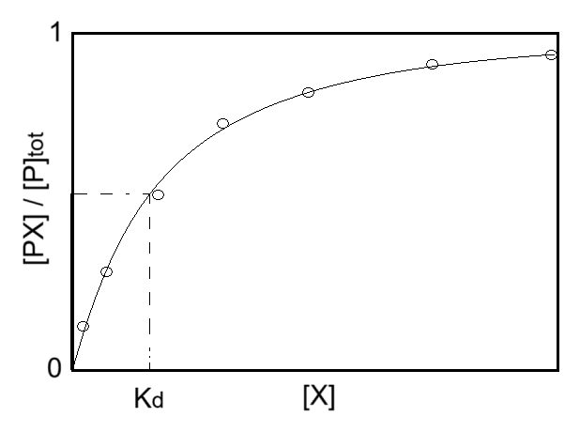
L’esperimento verrà in questo modo

Slide 22
Se il nostro scopo è determinare la stechiometria
Se lo scopo dell’esperimento è determinare la Kd le condizioni ideali sono:
[P]tot ≫ Kd
0 ≤ [X]tot ≤ 2-5 [P]tot
[P]tot ≈ [X]tot
In queste condizioni noi avremo [X] ≪ [PX] e potremo assumere
[PX] ≈ [X]tot
Poiché [X] è trascurabile rispetto a [X]tot, non sarà possibile determinare la Kd.

Slide 23
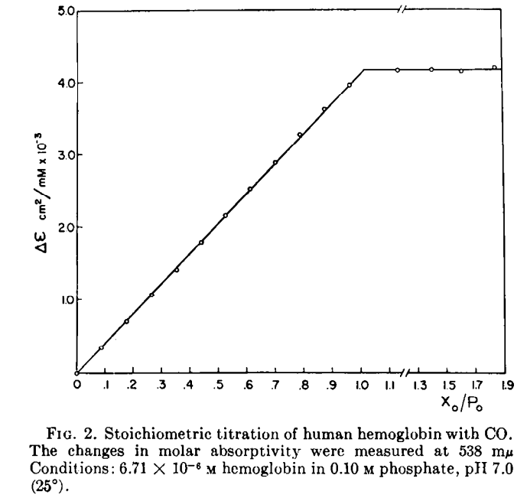
L’esperimento verrà in questo modo
Titolazione dell’emoglobina con il CO. Il CO libero è trascurabile. Anderson e Antonini, J. Biol. Chem. 243, 2918-2920.

Slide 24
PROBLEMS !
Several problems may become apparent during our carefully planned experiment; or, worse still, several problems may be present and go undetected, leading to wrong estimates of the parameters we intend to measure. Let’s consider:
Slowly binding ligands
Low affinity ligands
High affinity ligands
Poor signal or signal to noise ratio

Slide 25
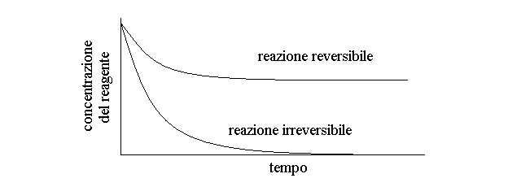
Slowly binding ligands
The rate of approach to equilibrium after each addition of ligand to the protein solution under the optimal condition [X]tot ≫ [P]tot is exponential or nearly exponential:

Slide 26
How long should I wait to reach equilibrium?
The apparent pseudo-first order rate constant of approach to equilibrium, after each ligand addition and under the condition [X]tot ≫ [P]tot is given by the sum of binding and dissociation rate constants:
kapp = kon [X] + koff
This rate “constant” is different with each ligand addition because it contains the variable term [X].
The only way to know that the equilibrium condition has been reached after each addition is to repeat the measurement and check that no further binding is occurring.

Slide 27
Definition of low- and high-affinity ligands
In order to obtain a ligand binding isotherm that can be reliably analyzed, we need to explore a ligand saturation range spanning at least from 0.2 to 0.8, corresponding to ligand concentrations from 0.25 Kd to 4 Kd. If we cannot obtain experimental points over the whole range, the analysis will be plagued by large uncertainties.
Low affinity ligands are those ligands that cannot reach the condition [X] ≥ 4 Kd.
High affinity ligands are those for which [X] ≤ 0.2 Kd can be reached only under conditions that negate the requirement [X]tot ≫ [P]tot.
Remember that [P]tot is dictated by the signal, whereas [X]tot is dictated by Kd.

Slide 28
Low-affinity ligands
Low affinity ligands cannot reach the condition [X] ≥ 4 Kd.
There may be several reasons for this problem:
the concentration required exceeds ligand solubility;
the concentration required entails significant effects on the solution itself (high ionic strength if the ligand is charged; high viscosity; etc.);
the concentration required perturbs the solution or the protein (e.g. it denatures the protein).

Slide 29
Overcoming the problem of low-affinity
Actually there are not many ways of overcoming the problem of low affinity, except if the binding reaction has a significant 𝛥H, either positive or negative.
We remember that:
𝛥G = 𝛥H - T 𝛥S = - RT ln K
Thus:
ln K = 𝛥S/R - 𝛥H/RT

Slide 30
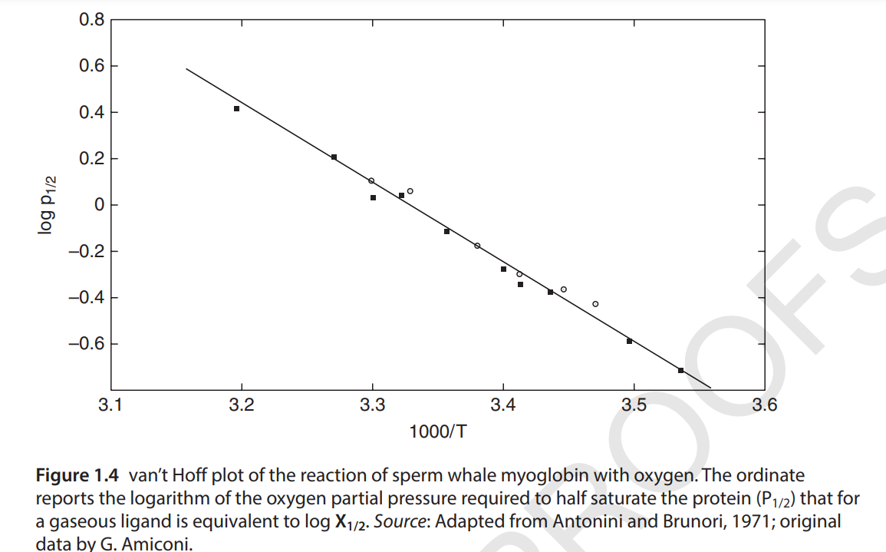
Taking advantage of the 𝛥H
The equation ln K = 𝛥S/R - 𝛥H/RT tells us that a plot of ln K versus 1/T yields a straight line with intercept 𝛥S/R and slope - 𝛥H/R (van t’Hoff plot).

Slide 31
Extrapolation of Kd
In conclusion, to overcome the problem of low-affinity ligands we can carry out a series of measurements at lower temperatures than the one we are interested in (if 𝛥H > 0) or at higher temperatures (if 𝛥H < 0) and linearly extrapolate the value of the Kd at the temperature we are interested in.

Slide 32
High-affinity ligands
In the case of high-affinity ligands, we may adopt the same strategy as for low-affinity ligands and determine the Kd over a temperature range that decreases ligand affinity, followed by extrapolation to the desired temperature.
However, in this case we also have a different trick up of our sleeve: ligand replacement reactions.

Slide 33
Replacement reactions
A ligand replacement reaction takes advantage of the competition between two ligands for the same binding site of the protein:
PX + Y ⇆ P + X + Y ⇆ PY + X
If at least one of the ligands has high affinity, the concentration of the unliganded protein will be negligible and we can semplify to:
PX + Y ⇆ PY + X
An obvious example of a replacement reaction is that of CO binding to oxy-hemoglobin:
HbO2 + CO ⇆ HbCO + O2

Slide 34
The ligand partition constant
If we carry out our experiment starting from a complex of the protein with the ligand with lower affinity, which is kept at constant concentration, and gradually add the ligand with higher affinity, we obtain a partition reaction, for which the mass law action dictates:
PX + Y ⇆ PY + X
Kp = [PY] [X] / [PX] [Y]
If Y is the lower affinity ligand, kept at constant concentration, we rewrite:
Kp’ = Kp [Y] = [PY] [X] / [PX]

Slide 35
From the partition constant to the affinity constant
Since we treat sour systems for dissociation reactions, the equation:
Kp’ = Kp [Y] = [PY] [X] / [PX]
implies that we can increase the value of Kp’ until its is within the range we desire by increasing the (fixed) concentration of the lower affinity ligand Y, and collect a series of ligand binding isotherms at different values of [Y]. From a set of Kp’ versus [Y] pairs, we can extrapolate the value of Kp. and calculate Kd,Y from the relationship:
Kp = Kd, Y / Kd, X

Slide 36
To summarize: high-affinity ligands
In practice, to measure the dissociation constant of a high-affinity ligand using the replacement method we proceed as follows:
select a competitive ligand (Y) with measurable affinity;
measure the Kd of this ligand (Kd,Y);
run a series of replacement reactions at different concentrations of Y and measure a series of Kp’ values;
extrapolate Kp
calculate Kd, Y = Kp / Kd, X

Slide 37
Poor signal or signal-to-noise ratio
What if the binding of the selected ligand does not yield a good signal or yields no signal at all?
Obviously we can select an artificial ligand that provides signal, e.g. a radioactively labelled ligand.
However, we can take advantage of the replacement reactions described previously, provided that we have a competing ligand (Y) that yields a good signal. We proceed as follows:
record the affinity of Y (measure Kd, Y) taking advantage of the signal provided by the transition P → PY
carry out a replacement reaction recording the transition PY → PX ; since P is similar to PX the signal will be due to the dissociation of Y.

Slide 38
Data analysis
Let’s suppose that you have collected a set of data; what next?
The first thing one can do is plotting the signal change as a function of [X]tot and draw a tentative curve on the experimental data, to obtain an estimate of Kd.

Slide 39
There must be better methods!
Clearly, drawing a hyperbola by hand is a difficult task; may be the curve we have drawn is not a hyperbola at all! In this case the Kdwe have estimated is a very rough approximation of the “real” value.
Methods have been devised to linearize the hyperbola, under the assumption that we are much better off if trying to draw a straight line through the experimental points, using a ruler.
The simplest linearization is to transform Kd = ([P]tot - [PX]) [X] / [PX]
into [PX] / ([P]tot - [PX]) = [X] / Kd
This yields a straight line crossing the origin of axes, with slope 1/Kd.

Slide 40
The Hill plot
A more refined linearization is due to the Nobel laureate A.V. Hill who proposed a logarithmic transformation of the previous equation:
log ([PX] / ([P]tot - [PX])) = log [X] - log Kd
The Hill plot has unitary slope, unless the protein is multimeric and cooperative, and intercept - log Kd.

Slide 41
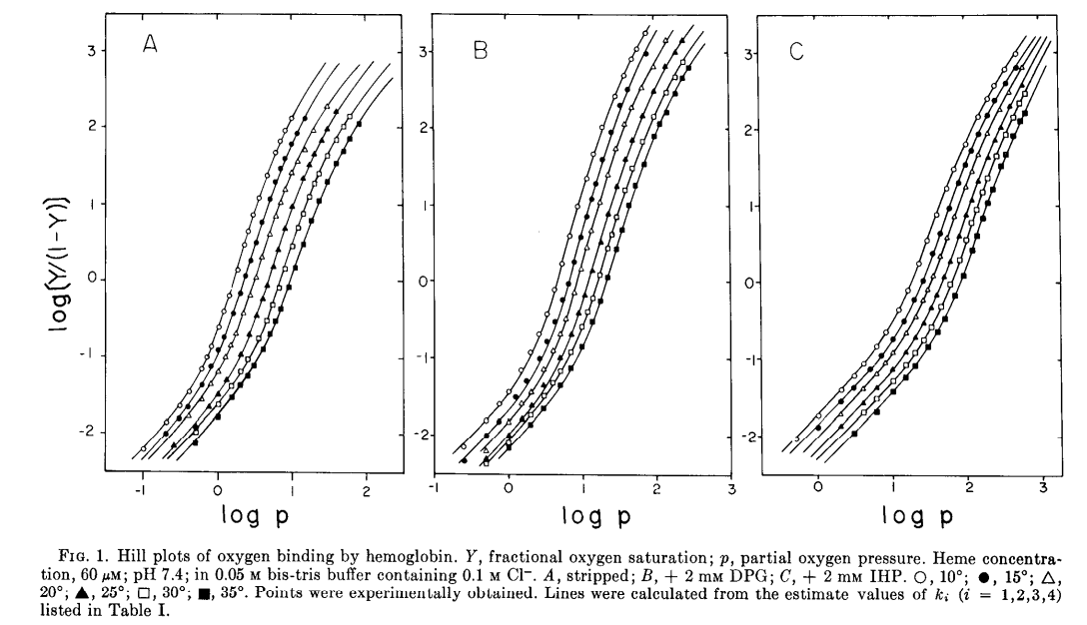

Slide 42
The problem of linearizations
Linearizations are not the best way to analyze ones’ data. The reason is that the arithmetic transformations required distort the experimental error and the points one obtains do not have all the same precision/error.

Slide 43
Least squares minimization routines
The availability of personal computers has drastically changed the procedures of data analysis. In order to take advantage of computers we need to state the problem we want to solve in the form of an algorithm that the computer can execute. Let’s define:
the experimental points are couples of ([X],signal change) coordinates
let’s call the signal change coordinate Yexp
we have a ligand binding function capable of calculating a value of Y using [X] and a set of parameters (Kd, total signal change, etc.); let’s call this value Ycalc
our task is to find the set of parameters which minimizes the sum of the squared differences between Yexp and Ycalc: 𝛴 (Ycalc - Yexp)²

Slide 44
Finding the minimum of the function 𝛴 (Ycalc - Yexp)² is usually not an exact procedure, i.e. it has no analytical solution; however the computer may calculate this value for a given set of parameters (Kd, total signal change), and vary each parameter slightly to detect in which direction the error function decreases; at the end of the procedure a new set of parameters, yielding a smaller error will be obtained and the procedure can be repeated (iterated), till a minimum is empirically found, or at least a parameter set that changes very little at every successive iteration.

